Slide 1




MBC 638: Data Analysis & Decision Making
Anna Chernobai
Lecture 05 – PART 4:
Simple and multiple regressions (Chapter 10)

Slide 2
Today: Regression analysis
0. Recall (Lecture 04): Association among numerical variables
Scatterplots
Covariance and Correlation
Simple linear regression
Multiple linear regression
Linear regressions with dummy variables and interaction variables
Nonlinear modeling possibilities

Slide 3



1. Regression with dummy variables
Data: Bank Salaries.xlsx
The Fifth National Bank of Springfield is facing a gender discrimination suit. The charge is that its female employees receive substantially smaller salaries than its male employees.
We have data on 208 employees.
Let’s use the data to figure out whether this claim is valid!

Slide 4
3. Regression with dummy variables
Dummy variables in regression models
Use Bank Salaries.xlsx data. (See Example 10.3 on page 561 of the textbook.)

Slide 5

Previously
QUESTION 1: Does gender affect salary?
Explanatory variable: Dummy variable (0=Male, 1=Female).
QUESTION 2: Does gender affect salary, after controlling for years of experience?
Explanatory variables: Dummy variable (0=M, 1=F); YrsExper.
QUESTION 3: DOES THE EFFECT OF YEARS OF EXPERIENCE ON SALARY DIFFER FOR MALES
AND FEMALES?
Explanatory variables: Dummy variable (0=M, 1=F); YrsExper; Dummy*YrsExper.

Slide 6
4. Nonlinear modeling possibilities
Modeling nonlinear effects in regression models
QUESTION 1: Does gender affect salary?
Explanatory variable: Dummy variable (0=Male, 1=Female).
QUESTION 2: Does gender affect salary, after controlling for years of experience?
Explanatory variables: Dummy variable (0=M, 1=F); YrsExper.
QUESTION 3: Does the effect of years of experience on salary differ for males and females?
Explanatory variables: Dummy variable (0=M, 1=F); YrsExper; Dummy*YrsExper.
QUESTION 4: HOW DOES EDUCATION LEVEL AFFECT SALARY?

Slide 7
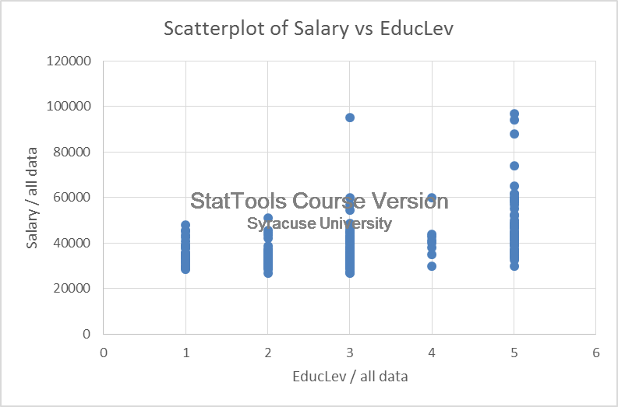
4. Nonlinear modeling possibilities
QUESTION 4: How does education level affect salary?
Scatterplot

Slide 8
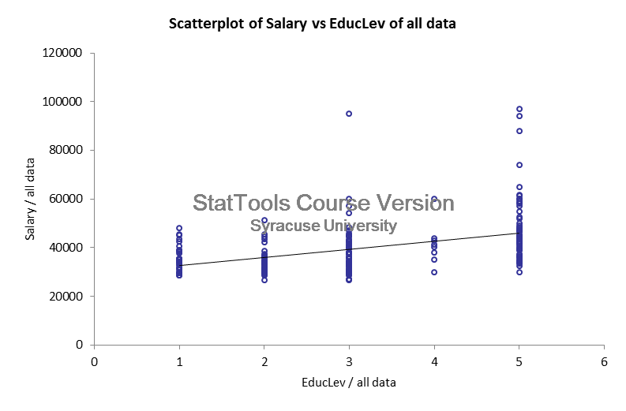
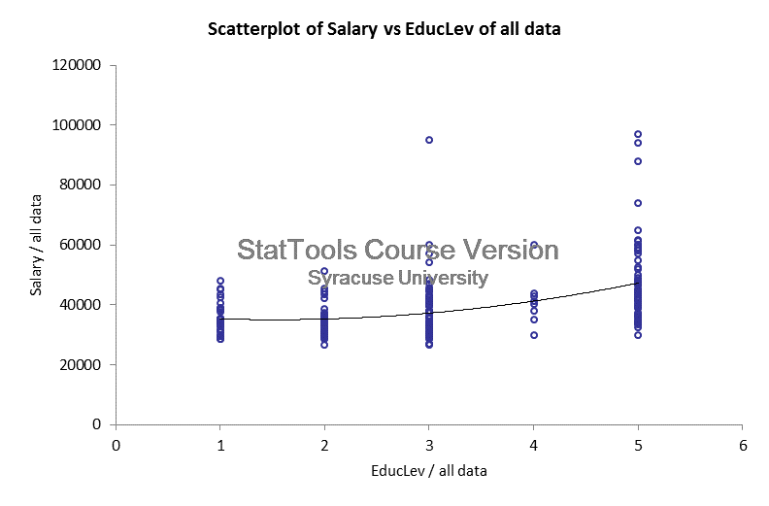
4. Nonlinear modeling possibilities
QUESTION 4: How does education level affect salary?
Nonlinear (quadratic)
Linear

Slide 9
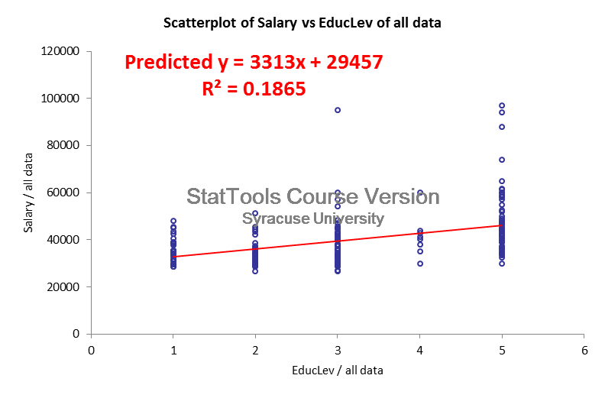
4. Nonlinear modeling possibilities
QUESTION 4: How does education level affect salary?
Some modeling possibilities:
Linear:
Ignore these for now.

Slide 10
4. Nonlinear modeling possibilities
QUESTION 4: How does education level affect salary?
Some modeling possibilities:
Linear:
Controlling for other factors

Slide 11
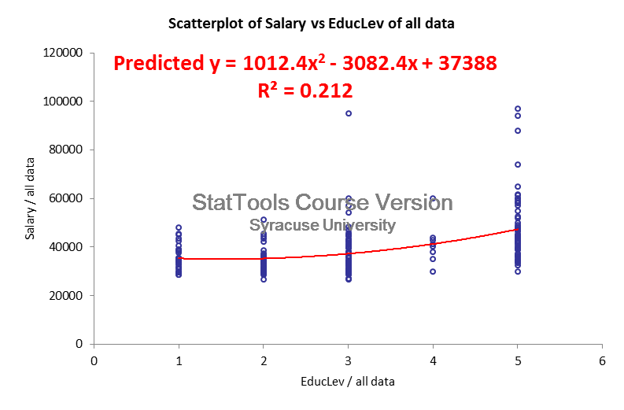
4. Nonlinear modeling possibilities
QUESTION 4: How does education level affect salary?
Some modeling possibilities:
Nonlinear (quadratic):

Slide 12
4. Nonlinear modeling possibilities
QUESTION 4: How does education level affect salary?
Some modeling possibilities:
Nonlinear (quadratic):
Controlling for other factors

Slide 13
4. Nonlinear modeling possibilities
QUESTION 4: How does education level affect salary?
Some modeling possibilities:
Nonlinear (with dummy variables):
Create dummy variables:
Educ1 = EducLevel=1 (high school)
Educ2 = EducLevel=2 (some college)
Educ3 = EducLevel=3 (bachelor’s degree)
Educ4 = EducLevel=4 (some graduate)
Educ5 = EducLevel=5 (graduate degree)
IMPORTANT RULE: In regressions, use all dummies except one (Example: Use dummies Educ2-Educ5, leave Educ1 out as reference category). We would expect greater increases in salary for higher education levels.

Slide 14
4. Nonlinear modeling possibilities
QUESTION 4: How does education level affect salary?
Some modeling possibilities:
Nonlinear (with dummy variables):
Create dummy variables:
Educ1 = EducLevel=1 (high school)
Educ2 = EducLevel=2 (some college)
Educ3 = EducLevel=3 (bachelor’s degree)
Educ4 = EducLevel=4 (some graduate)
Educ5 = EducLevel=5 (graduate degree)
In regressions, use all dummies except one.
Use dummies Educ2-Educ5, leave Educ1
out as reference category.

Slide 15
4. Nonlinear modeling possibilities
QUESTION 4: How does education level affect salary?
Some modeling possibilities:
Nonlinear (with dummy variables):
Create dummy variables:
Educ1 = EducLevel=1 (high school)
Educ2 = EducLevel=2 (some college)
Educ3 = EducLevel=3 (bachelor’s degree)
Educ4 = EducLevel=4 (some graduate)
Educ5 = EducLevel=5 (graduate degree)
In regressions, use all dummies except one.
Use dummies Educ2-Educ5, leave Educ1
out as reference category.
Controlling for other factors

Slide 16
4. Nonlinear modeling possibilities
Modeling nonlinear effects in regression models
QUESTION 1: Does gender affect salary?
Explanatory variable: Dummy variable (0=Male, 1=Female).
QUESTION 2: Does gender affect salary, after controlling for years of experience?
Explanatory variables: Dummy variable (0=M, 1=F); YrsExper.
QUESTION 3: Does the effect of years of experience on salary differ for males and females?
Explanatory variables: Dummy variable (0=M, 1=F); YrsExper; Dummy*YrsExper.
QUESTION 4: HOW DOES EDUCATION LEVEL AFFECT SALARY?

Slide 17
Data: Bank Salaries.xlsx
The Fifth National Bank of Springfield is facing a gender discrimination suit. The charge is that its female employees receive substantially smaller salaries than its male employees.
So, what’s the verdict?

Slide 18

Today: Regression analysis
0. Recall (Lecture 04): Association among numerical variables
Scatterplots
Covariance and Correlation
Simple linear regression
Multiple linear regression
Linear regressions with dummy variables and interaction variables
Nonlinear modeling possibilities

